Slide 1

Bregman divergences, dual information geometry, and generalized comparative convexity
Frank Nielsen
Sony Computer Science Laboratories Inc.
Tokyo, Japan
https://franknielsen.github.io/
November 2021

Slide 2
Outline
Bregman divergences
Dual information geometry & Bregman manifolds
Generalized convexity and designing divergences from convexity gaps

Slide 3
Part I. Bregman divergences: - Legendre-Fenchel transformation (dual parameterization) - Fenchel-Young divergences (mixed parameterization) - Statistical divergences, statistical models & Bregman divergences

Slide 4
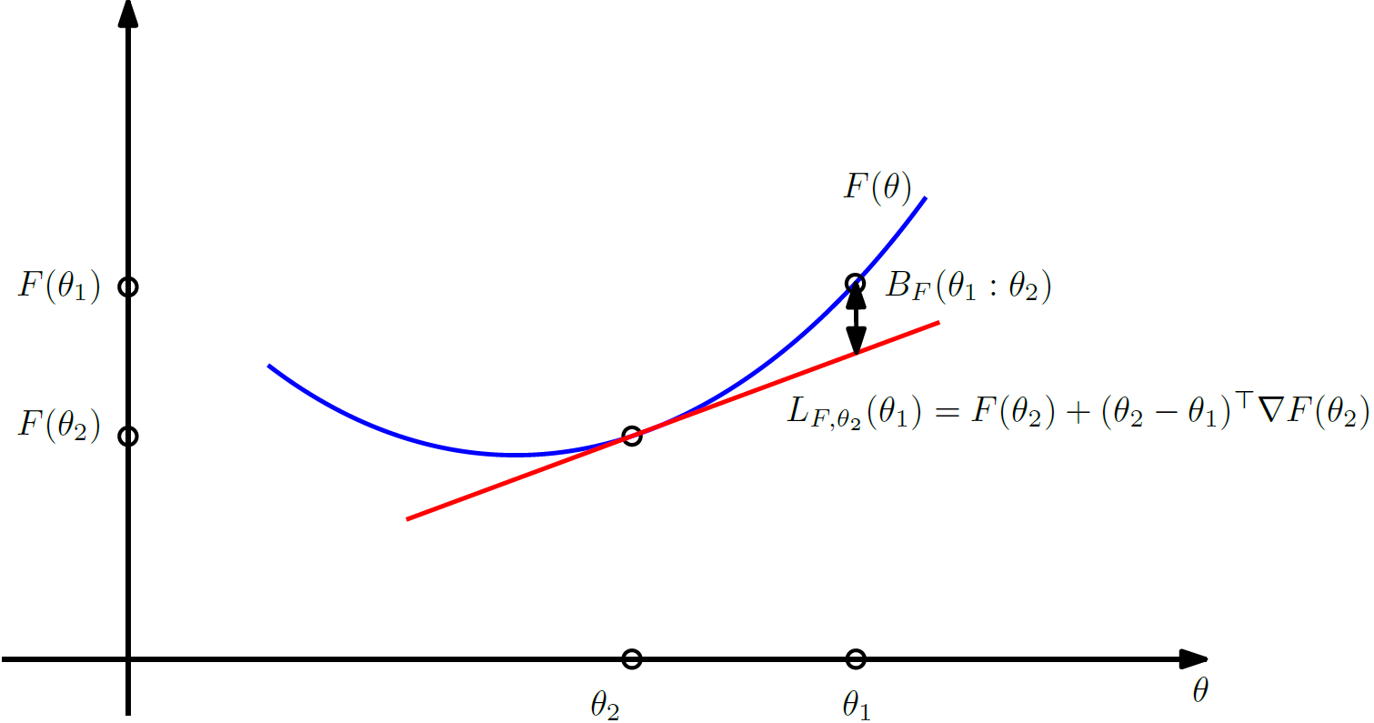
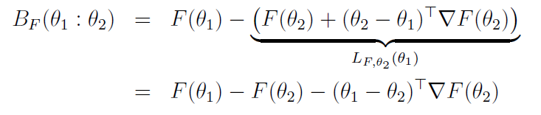
Bregman divergences
F(θ): strictly convex and differentiable convex function on an open convex domain ϴ
Design the Bregman divergence as the vertical gap between F(θ₁) and the linear approximation of F(θ) at θ₂ evaluated at θ₁ :
[Bregman 1967]

Slide 5
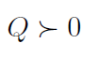

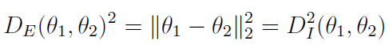

Bregman divergences: Some properties
Positive-definite:
B_{F}(θ₁ : θ₂) > 0 when θ₁ ≠ θ₂
B_{F}(θ₁ : θ₂) = 0 if and only if θ₁ = θ₂
Symmetric only for generalized squared Euclidean/Mahalanobis distance, asymmetric otherwise
Does not satisfy the triangle inequality of metric distances
Smooth/differentiable w.r.t. parameters ⇒ divergences (contrast functions)
[N+ 2007]
[N+ 2007] Bregman Voronoi diagrams: Properties, algorithms and applications, arXiv:0709.2196

Slide 6
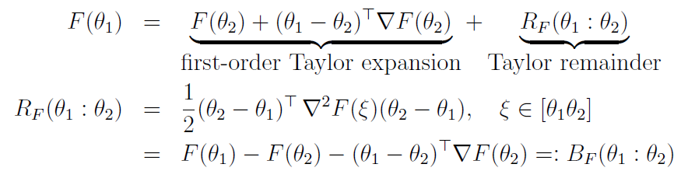
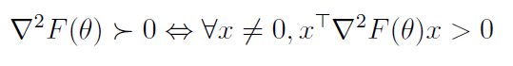
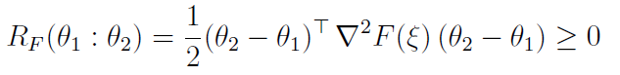
Bregman divergences: 1st order Taylor remainder
Bregman divergence (BD) can be interpreted as the mean-value remainder of a first-order Taylor expansion of F(θ) at θ₂ :
Since F is strictly convex, the Hessian is positive-definite:
and this proves that BDs are positive-definite:

Slide 7
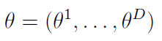
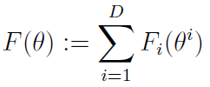
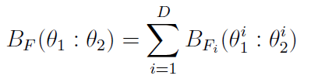
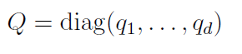
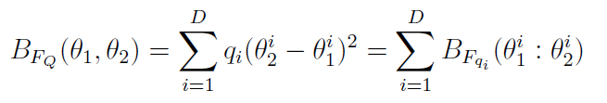
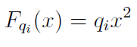
Scalar and separable Bregman divergences
D-variate Bregman divergence w.r.t. parameter
Separable: Bregman generator is sum of univariate/scalar Bregman generators:
For example, generalized square Euclidean distance with diagonal matrix Q

Slide 8
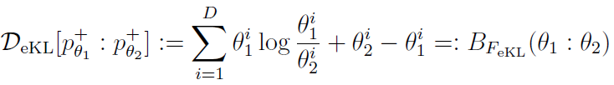
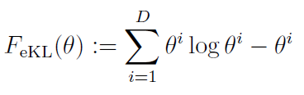
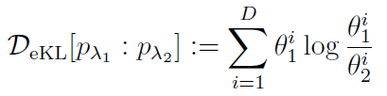
Extended Kullback-Leibler divergence
Extended Kullback-Leibler divergence (eKL) is a D-dimensional separable Bregman divergence induced by the Shannon negentropy Bregman generator:
p⁺ means a positive measure (not necessarily normalized to a probability)
When p⁺ is normalized:
eKL divergence also called extended relative entropy in information theory
Lafferty, Lebanon, Boosting and maximum likelihood for exponential models, NeurIPS 14 (2002)

Slide 9
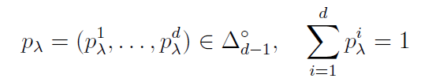
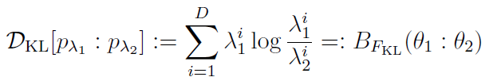
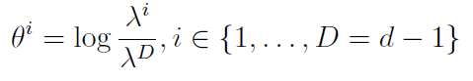
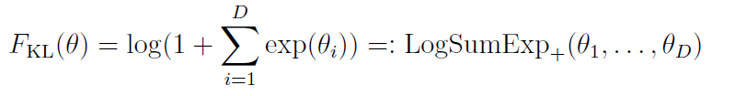
Discrete Kullback-Leibler divergence: A non-separable Bregman divergence
The KLD between two categorical distributions a.k.a. multinoulli amounts to a non-separable Bregman divergence on the natural parameters of the multinoulli distributions interpreted as an exponential family.
LogSumExp is only convex but LogSumExp₊ is strictly convex
[NH 2019]
[NH 2019] Monte Carlo information-geometric structures, Geometric Structures of Information, 2019.
Guaranteed bounds on information-theoretic measures of univariate mixtures using piecewise log-sum-exp inequalities, Entropy, 18(12), 2016

Slide 10
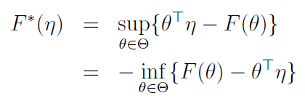
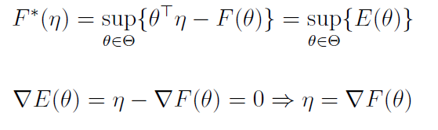
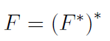
Legendre-Fenchel transformation
Consider a Bregman generator of Legendre-type (proper, lower semi-continuous). Then its convex conjugate obtained from the Legendre-Fenchel transformation is a Bregman generator of Legendre type.
Legendre-Fenchel transformation applies to any multivariate function
Analogy of the Halfspace/Vertex representation of the epigraph of F
Fenchel-Moreau’s biconjugation theorem for F of Legendre-type:
Concave programming:
[Touchette 2005] Legendre-Fenchel transforms in a nutshell
[N 2010] Legendre transformation and information geometry
Notes:
proper, lower semi-continuous, and convex function,

Slide 11
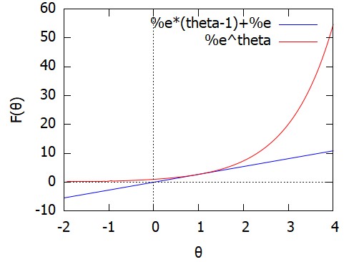
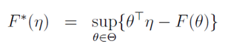
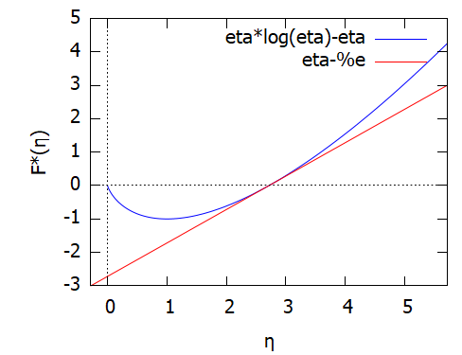
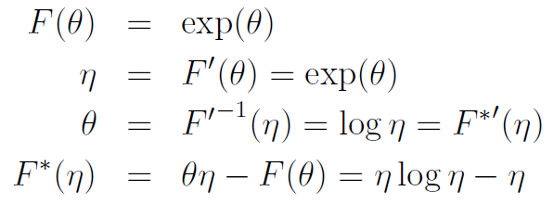
Reading the Legendre-Fenchel transformation
Legendre-Fenchel transformation also called the slope transform
Points/Lines
(Here, F was chosen as the cumulant function of the Poisson distributions)
Notes:
\begin{eqnarray*}
F(\theta)&=&\exp(\theta)\\
\eta&=&F'(\theta)=\exp(\theta)\\
\theta&=& {F'}^{-1}(\eta) =\log\eta= {F^*}'(\eta)\\
F^*(\eta)&=&\theta\eta-F(\theta)=\eta\log\eta-\eta
\end{eqnarray*}

Slide 12
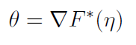
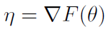
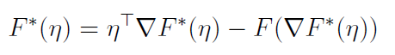
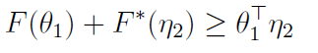
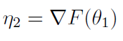

Legendre-Fenchel transform: Mixed coordinates and Fenchel-Young divergence
Dual parameterizations of epigraph: and
Convex conjugate expressed as :
To get in closed form the convex conjugate F*, we need ∇F*(η), i.e., invert ∇F(θ)
Fenchel-Young inequality:
with equality if and only if
Fenchel-Young divergence use mixed parameterization θ/η:

Slide 13
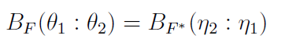
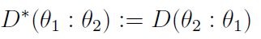

Dual Bregman and dual Fenchel divergences
Identity of dual Bregman divergences:
In general, dual or reverse divergence:
Primal, dual or mixed parameterizations of Bregman divergences:

Slide 14

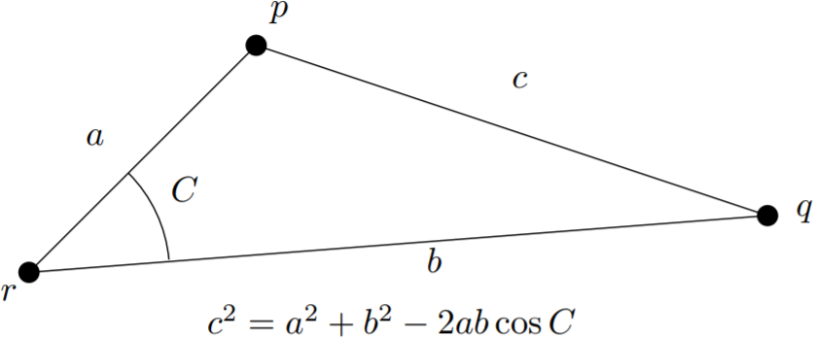
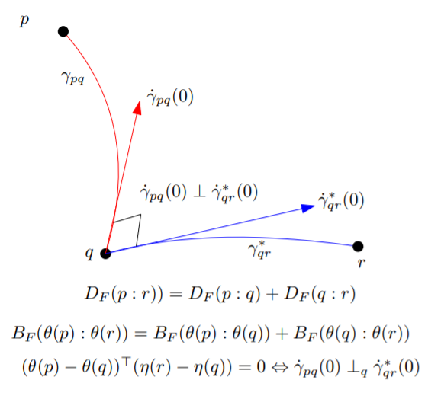
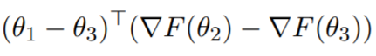
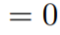
3-parameter identity of Bregman divergences
Generalize the law of cosines for the squared Euclidean distance
Yields a generalization of the Pythagorean theorem
when
On geodesic triangles with right angles in a dually flat space, Progress in Information Geometry: Theory and Applications, 2021

Slide 15
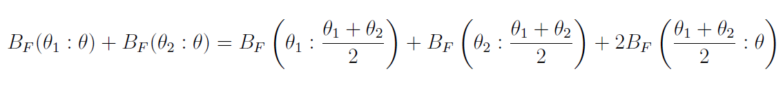
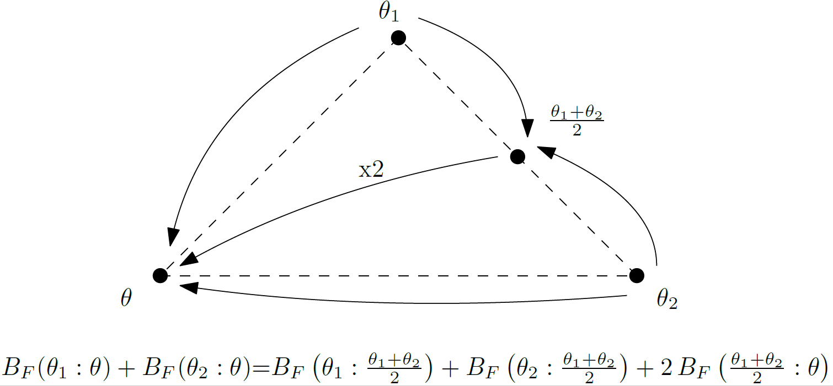
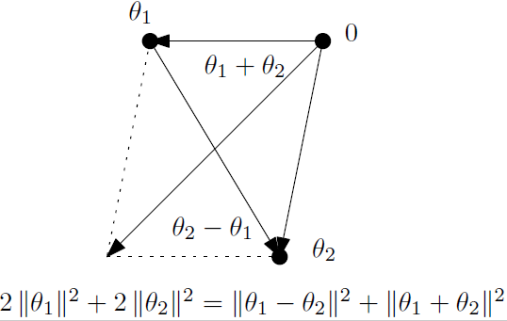
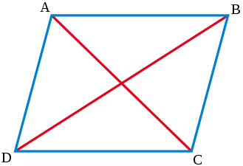
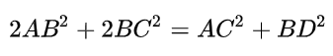
4-parameter identity of Bregman divergences
Parallelogram identity
In Euclidean geometry:
On geodesic triangles with right angles in a dually flat space, Progress in Information Geometry: Theory and Applications, 2021

Slide 16
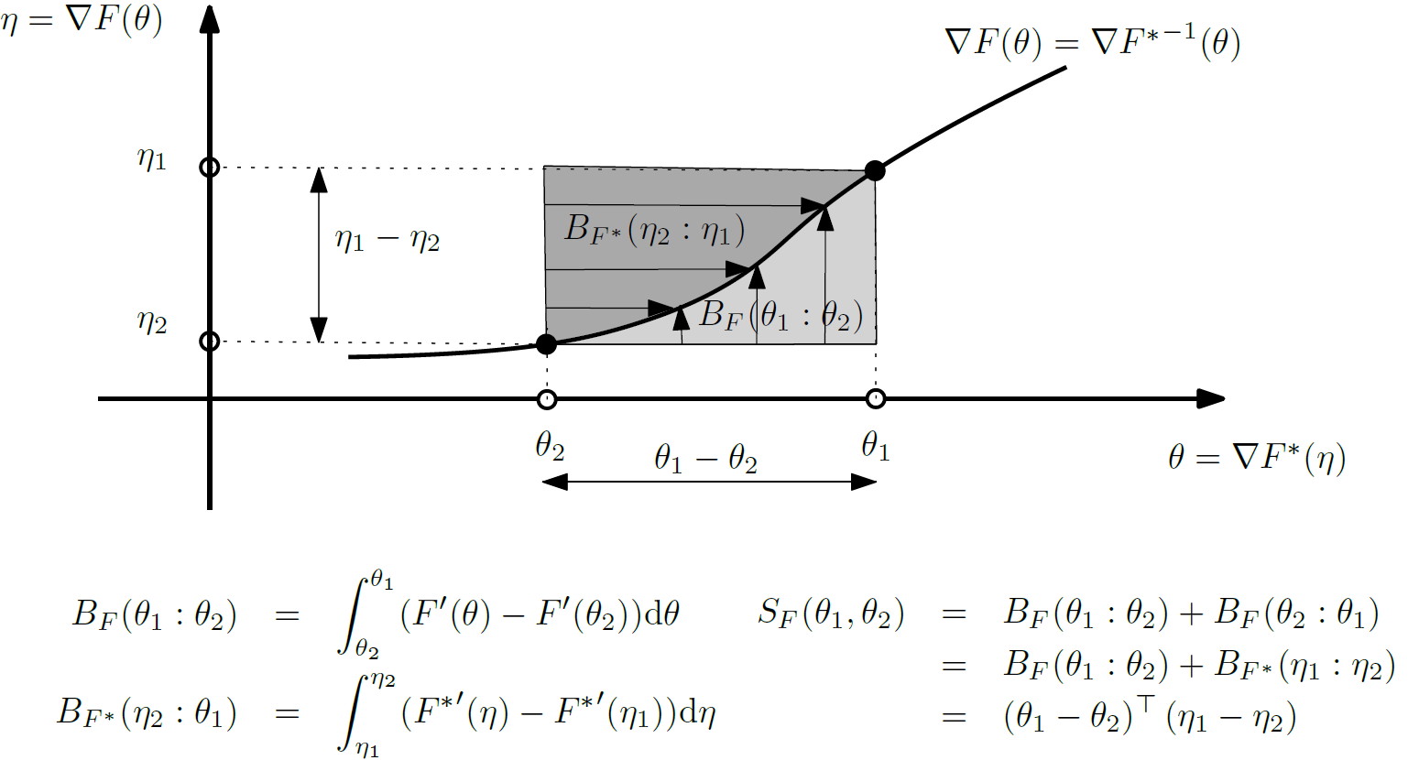
Symmetrized Bregman divergence: Geometric reading
[arXiv:2107.05901]
Notes:
Dual Bregman divergences can be interpreted as definite integral areas.
Thus the symmetrized Bregman divergence is interpreted as an area integral.
https://arxiv.org/abs/2107.05901

Slide 17
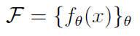
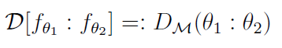
Statistical divergences between parametric models = parameter divergences
Statistical divergences between densities of a parametric model amount equivalently to (parameter) divergences between corresponding parameters:
For which statistical models and statistical divergences,
do we obtain D_{M}(θ₁ : θ₂) as a Bregman divergence?

Slide 18
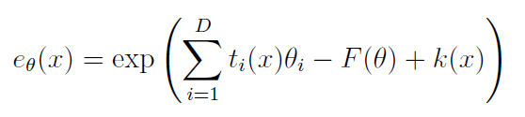
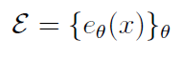
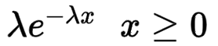
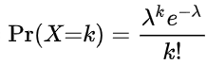



Example 1: Natural exponential family models
Parametric model with densities
Examples of natural exponential families:
Exponential distributions (continuous): p.d.f.
Poisson distributions (discrete): p.m.f.
Examples of exponential families with density
Gaussian distributions once reparameterized with natural parameters
θ(λ)=θ(μ,σ²)
We have with Bregman generator:
the log-normalizer convex real-analytic function:
On a Variational Definition for the Jensen-Shannon Symmetrization of Distances Based on the Information Radius, Entropy (2021)

Slide 19







Example 2: Mixture family models
Let 1, p₀(x), …,p_{D}(x) be (D+2) linearly independent densities
Mixture family with densities:
We have:
with the Bregman generator = Shannon negentropy:
Usually F_{M}(θ) not in closed-form…
But 2-mixture family of Cauchy distributions has closed-form!
Information geometry/reconstruction
Natural parameters
The dually flat information geometry of the mixture family of two prescribed Cauchy components, arXiv:2104.13801

Slide 20





Example 3: q-Gaussians and statistical divergence
The set of Cauchy distributions
form a q-Gaussian exponential family for q=2
Deformed exponential family generalize exponential family with deformed log/exp functions
Cumulant function of the Cauchy 2-Gaussian family:
The following statistical divergence between 2 Cauchy distributions amount to a Bregman divergence:
Bregman generator is the q-free energy for q=2
On Voronoi diagrams on the information-geometric Cauchy manifolds, Entropy 22.7 (2020)

Slide 21



Information geometry & Bregman divergences
Bregman divergences are canonical divergences of dually flat spaces (Bregman manifolds)
Information geometry gives a principle to reconstruct the statistical divergence corresponding to a Bregman divergence for a Bregman generator F(f_{θ}), and not the converse
Bregman generator
Bregman divergence
Statistical divergence
An elementary introduction to information geometry." Entropy 22.10 (2020)

Slide 22



Class of Bregman generators modulo affine terms & KLD between exponential family densities expressed as log-ratio
Bregman generators are strictly convex and differentiable convex functions defined modulo affine terms: B_{F}=B_{G} iff. F(θ)=G(θ)+Aθ +b
Choose for any ω in the support of the exponential family the Bregman generator:
We get:
By choosing s points:
Computing Statistical Divergences with Sigma Points. GSI 2021
Cumulant-free closed-form formulas for some common (dis)similarities between densities of an exponential family, arXiv:2003.02469

Slide 23

Part II. Information geometry & Bregman manifolds
statistics
divergence
geometry
models
The fabric of information geometry
and the untangling of its geometry, divergence, statistical models

Slide 24

Motivation & history of information geometry
Information geometry studies the geometric structures and statistical invariance principles (sufficient statistics, Markov kernels) of a family of probability distributions (=statistical model) and demonstrate their use in information sciences (statistics, ML).
The newly revealed geometric structures (e.g., dually flat space) can also be used in non-statistical contexts (e.g., mathematical programming)
Born as a mathematical curiosity! Use Fisher information matrix as a Riemannian metric = Fisher metric [Hotelling 1930] [Rao 1945]
Decouple metric tensor with Levi-Civita connection, consider a family of affine connections [Chenstov 1960-1970’s] : Geometrostatistics
Statistical curvature, Efron’s e-connection, Dawid’s m-connection [Efron 1975]
Consider dual torsion-free affine connections coupled to the metric, explicit
α-structures [Amari 1980’s] (Amari-Chentsov totally symmetric cubic tensor)
Non-parametric information geometry [Pistone 1990’s], quantum information geometry, algebraic statistics, geometric science of information, etc.

Slide 25























Notes:
Some books on information geometry and its related topics…

Slide 26
Part II.A - Fisher-Riemannian geometry

Slide 27








Fisher information matrix (FIM)
A parametric family of distributions
Fisher information matrix is positive-semidefinite matrix:
Under independence, Fisher information is additive:
Under regularity conditions I (FIM type 1) :
Under regularity conditions II (FIM type 2):
FIM can be singular (hierarchical models like mixtures, neural networks in ML)
FIM can be infinite (irregular models, e.g., support depend on parameters )
Score:
N., Cramér-Rao lower bound and information geometry, Connected at Infinity II, 2013
Soen and Sun, On the Variance of the Fisher Information for Deep Learning, NeurIPS 2021
Notes:
Fisher information matrix is defined as the covariance of the score.
FIM is additive for random vectors with independent random variables.
It can be singular (hierarchical models like mixtures/NNs) and even infinite
https://arxiv.org/abs/1301.3578
-----
$$
X=(x_1,\ldots,x_D)^\top\sim p_\theta
$$
$$
\mathcal{P}=\{p_\theta\}_{\theta\in\Theta}
$$
$$
I_X(\theta)=[I_{ij}(\theta)]_{ij}\succeq 0, \quad I_{ij}(\theta):=\Cov_{p_\theta}(x_i,x_j)
$$
$$
Y=(Y_1,\ldots,Y_n)_{\sim_{\mathrm{iid}} p_\theta}\quad \Rightarrow\quad I_Y(\theta)=n\,I_X(\theta)
$$
$$
I_1(\theta)=E_{p_\theta}\left[(\nabla_\theta \log p_\theta) (\nabla_\theta \log p_\theta)^\top\right]
$$
$$
I_2(\theta)= -E_{p_\theta}\left[\nabla^2_\theta \log p_\theta\right]
$$

Slide 28


Key concept: Sufficient statistics
A statistic is a function of a random vector (e.g., mean, variance)
A sufficient statistic collect and concentrate from a random sample all necessary information for estimating the parameters.
Informally, a statistical lossless compression scheme…
Definition: conditional distribution of X given t does not depend on θ
Fisher-Neyman factorization theorem: Statistic t(x) sufficient iff. the density can be decomposed as:
Statistical exponential families: A digest with flash cards, arXiv:0911.4863 (2009)

Slide 29




Natural exponential families (NEF)
Consider a positive measure (usually counting or Lebesgue)
A natural exponential family is a parametric family of densities that write as
where F is real-analytic, strictly convex and differentiable:
F: Log-normalizer (also known as partition function, cumulant function, etc.)
Natural parameter space
Barndorff-Nielsen, Information and exponential families: in statistical theory. John Wiley & Sons, 2014
Sundberg, Statistical modelling by exponential families. Vol. 12. Cambridge University Press, 2019
N., Garcia, Statistical exponential families: A digest with flash cards." arXiv:0911.4863

Slide 30



Exponential families (from Natural EFs to EFs)
Consider a (sufficient) statistic t(x)
Consider an additional carrier measure term k(x)
Consider an inner product between t(x) and θ
(usual scalar/dot product)
Properties:
(Hessian of –log p_{θ}(x))
(FIM type 2)
Exponential families have finite moments of any order
Notes:
\def\inner#1#2{{\langle #1, #2\rangle}}
p_{\theta}(x)= \exp(\inner{\theta}{t(x)}-F(\theta)+k(x))

Slide 31

Many common distributions are exponential families in disguise
Statistical exponential families: A digest with flash cards, arXiv:0911.4863 (2009)
Tojo and Yoshino, On a method to construct exponential families by representation theory, GSI 2019 (Springer)

Slide 32








Bhattacharyya arc: Likelihood Ratio Exponential Family
Bhattacharyya arc or Hellinger arc induced by two mutually absolutely continuous distributions p and q (same support ):
Log-normalizer F(λ) (aka cumulant generating function, log partition function):
Bhattacharyya arc (geometric mixtures) = 1D exponential family:
Log-likelihood sufficient statistics:
Base measure is p₀
Generalizing the Geometric Annealing Path using Power Means, UAI 2021
Likelihood Ratio Exponential Families, NeurIPS Workshop on Deep Learning through Information Geometry 2020
Notes:
*Statistical geometric mixtures* induced by two probability distributions = Bhattacharyya/Hellinger arc =1D exponential family with sufficient statistic the log ratio of densities and log-normalizer minus the skewed α-Bhattacharyya distance. #NeurIPS2020 ws on DL through information geometry @brekelmaniac thermodynamic variational objectives, rate distortion, information bottleneck
-----
$$
\calX
$$
$$
\mathcal{E}(p,q):=\left\{ p_\lambda(x):= \frac{p^{1-\lambda}(x)q^\lambda(x)}{Z^G_\lambda(p,q)} ,\quad \lambda\in (0,1)\right\}
$$
$$
Z^G_\lambda(p,q):=\int_{\calX} {p^{1-\lambda}(x)q^\lambda(x)}\dmu(x)
$$
\begin{eqnarray*}
p_\lambda(x) &=& \frac{p_0^{1-\lambda}(x)p_1^\lambda(x)}{Z^G_\lambda(p,q)}\\
&=& p_0(x)\exp\left(\lambda \log\left(\frac{p_1(x)}{p_0(x)}\right) -\log Z^G_\lambda(p,q)\right)\\
&=& \exp\left(\lambda t(x)-F(\lambda)+k(x)\right)
\end{eqnarray*}
$$
t(x):=\log\left(\frac{p_1(x)}{p_0(x)}\right)
$$
$$
k(x):=\log p_0(x)
$$
\begin{eqnarray*}
F(\lambda) &:=& \log(Z^G_\lambda(p,q))=\log \left(\int_{\calX} {p^{1-\lambda}(x)q^\lambda(x)}\dmu(x)\right)\\
&=:& -D^{\Bhat}_\lambda[p:q]
\end{eqnarray*}
$$
D^{\Bhat}_\alpha[p:q] :=-\log\left( \int_{\calX} {p^{1-\alpha}(x)q^\alpha(x)}\dmu(x)\right)
$$

Slide 33




Rao’s length distance (Riemannian distance)
(M,g) Riemannian manifold: Parameter space equipped with the Fisher information metric
Invariant under smooth & bijective reparameterization
E.g., normal family: (μ,σ), (μ,σ²), (μ,log σ)
FIM is covariant under reparameterization
C. R. Rao with
Sir R. Fisher in 1956
Rao distance in the probability simplex:
Square root
embedding
Notes:
https://demonstrations.wolfram.com/PseudosphereGeodesics/

Slide 34






Rao’s distance between 1D normal distributions
Fisher information metric becomes the Poincare upper plane metric
after scale change of variable
FIM of normals
Poincare upper space
Pseudo-sphere
partial embedding
in R³
On Voronoi diagrams on the information-geometric Cauchy manifolds, Entropy 22.7 (2020)

Slide 35


In practice, calculating Rao’s distance may be difficult!
E.g., no closed form
of Rao’s distance
between multivariate normals
Need to solve the Ordinary Differential Equation (ODE) for find the geodesic:
Need to integrate the infinitesimal length elements ds along the geodesics
Notes:
https://golem.ph.utexas.edu/category/2018/05/the_fisher_metric_will_not_be.html
http://robotics.snu.ac.kr/fcp/files/_pdf_files_publications/201312_DTI%20Segmentation.pdf
https://www.researchgate.net/publication/282538992_Geodesic_Hypothesis_Testing_for_Comparing_Location_Parameters_in_Elliptical_Populations

Slide 36


Approximating geodesics for MVNs: geodesic shooting
ODE with boundary value conditions
Minyeon Han · F.C. Park, DTI Segmentation and Fiber Tracking Using Metrics on Multivariate Normal Distributions, 2014
Calvo, Miquel, and Josep Maria Oller. "An explicit solution of information geodesic equations for the multivariate normal model." Statistics & Risk Modeling 9.1-2 (1991): 119-138.
Notes:
Remarks on geodesics for multivariate normal models Takuro Imai, Akira Takaesu and Masato Wakayama

Slide 37
Part II.B - Dual information geometry

Slide 38



Another look at Riemannian geodesics: Connections
Riemannian geodesics are locally minimizing length curves
The general definition of geodesics is wrt. to an affine connection:
For Riemannian geodesics, the default connection = Levi-Civita connection.
This special Levi-Civita connection is derived from the metric tensor g.
A geodesic γ(t) with respect to a connection ∇ is an ∇-autoparallel curve
(straight free fall particle in physics ):
where ∇_{X}T is the covariant derivative of a tensor T wrt. a vector field X
An elementary introduction to information geometry, Entropy 22.10 (2020)

Slide 39




What makes the Levi-Civita connection so special?
A connection is described by Christoffel symbols (functions Γ), and the geodesics is described by this ODE:
An affine connection defines how to parallel transport a vector from one tangent plane to another tangent plane
Fundamental theorem of Riemann geometry:
Levi-Civita connection is the unique torsion-free metric connection induced by the metric tensor g
An elementary introduction to information geometry, Entropy 22.10 (2020)

Slide 40

∇ : Curvature, torsion, and parallel transport
Cylinder is flat
Parallel transport is
independent of path
Sphere has constant curvature
Parallel transport is path-dependent
A connection is flat is there exists locally a coordinate system such that the Christofel symbols are all zero: Geodesics plotted in that coordinate system are line segments
Torsion tensor
Connections that differ only on torsions yield same geodesics
Notes:
https://images.math.cnrs.fr/Visualiser-la-courbure.html?lang=fr

Slide 41






Dualistic information geometry:
Given an affine torsion-free connection ∇ and a metric g, we can build a unique dual affine torsion-free connection: the dual connection ∇* such that the metric (inner product) is preserved by the primal and dual parallel transports:
This amounts to say that ∇* is defined uniquely by
The dual of a dual connection is the primal connection:
meaning
An elementary introduction to information geometry, Entropy 22.10 (2020)

Slide 42





Amari/Chentsov’s α-structures
Regular statistical parametric models (identifiable and finite positive-definite FIM)
Amari’s α-connections
0-connection is Fisher Levi-Civita connection
1-connection is exponential connection (flat for exponential families)
-1 connection is mixture connection (flat for mixture families)
Amari, Differential geometry of curved exponential families-curvatures and information loss, Annals of Statistics (1982)

Slide 43






Lauritzen’ statistical manifolds: Cubic tensor
Beware: Apply also to non-statistical contexts too!
Dualistic structure with metric tensor g and cubic tensor C
C is totally symmetric (= components invariant by index permutation)
In a local basis:
Levi-Civita connection is self-dual with respect to the metric!
Lauritzen, Statistical manifolds, Differential geometry in statistical inference 10 (1987)

Slide 44








Eguchi’s Information geometry of divergences
Reverse/dual parameter divergence (reference duality)
Statistical manifold structures:
Eguchi, Geometry of minimum contrast, Hiroshima Mathematical Journal 22.3 (1992)

Slide 45
Part II.C - Bregman manifolds: Dually flat spaces

Slide 46

Dually flat geometry from a convex function
Not necessarily related to statistical models,
but can always be realized by a regular statistical model
Vân Lê, Hông. "Statistical manifolds are statistical models." Journal of Geometry 84.1-2 (2006)

Slide 47




Crouzeix’s identity: x of Hessians of convex conjugates= Id:
Metric tensor using covariant/contravariant notations
2-covariant metric tensor in local coordinates:
Dual metric tensor in local coordinates:
Reciprocal basis
An elementary introduction to information geometry." Entropy 22.10 (2020)
Notes:
\nabla^{2} F(\theta) \nabla^{2} F^{*}(\eta)=I
g_{ij}(\theta)=\nabla^2F(\theta)
g^{ij}(\eta)={g^*}^{ij}(\eta)=\nabla^2 F(\eta)

Slide 48






Bregman information geometry: Bregman manifolds
Start from a potential function F(θ)
Get the dual potential function F*(η)
Define the primal flat connection:
Define the dual flat connection:
Get the dual Bregman divergences
or dual Fenchel-Young divergences
The many faces of information geometry, Notices of the AMS, January 2022

Slide 49









Bregman manifolds vs Hessian manifolds
Hessian metric wrt. a flat connection ∇, function is 0-form on M:
Hessian operator:
Bregman manifold: geometry on an open convex domain:
Riemannian Hessian metric when
∇ flat
Here, ∇ = gradient
Here, ∇, ∇* = affine flat connections
N., On geodesic triangles with right angles in a dually flat space, Progress in Information Geometry: Theory and Applications, Springer, 2021

Slide 50
Part III Generalized convexity and divergences from convexity gaps

Slide 51










Chordal slope lemma & Jensen/Bregman divergences
Jensen
Divergence (JD)
Bregman
Divergences
(BDs):
BD as a limit of a scaled JD:
[EIG, Entropy 2020]
Notes:
Bregman divergences and skew Jensen divergences can be derived from the chordal slope theorem of a strictly convex function.
Furthermore, Bregman divergence can be obtained as the limit of a skew Jensen divergence.
https://www.mdpi.com/1099-4300/22/10/1100

Slide 52




Bregman divergences wrt comparative convexity
Two abstract means M and N, i.e.
Define a function F (M,N) convex if
Consider the means regular: homogeneous, symmetric continuous, and increasing in each variable
Define skew (M,N)-Jensen divergence for a strictly convex (M,N)-function for regular means M and N:
By analogy of ordinary Bregman divergences obtained as limit of scaled skew Jensen divergences, define (M,N)-Bregman divergences:
Generalizing skew Jensen divergences and Bregman divergences with comparative convexity, IEEE Signal Proc. Letters (2017)

Slide 53




Quasi-arithmetic (rho-tau)-Bregman divergences
For a strictly continuously monotone function γ, define the
weighted quasi-arithmetic means
Quasi-arithmetic Bregman divergence:
Consider the ordinary convex function:
Quasi-arithmetic (rho-tau)-Bregman divergences is a conformal regular Bregman divergence:
Generalizing skew Jensen divergences and Bregman divergences with comparative convexity, IEEE Signal Proc. Letters (2017)
Nock, N., Amari, On conformal divergences and their population minimizers, IEEE Transactions on Information Theory 62.1 (2015)

Slide 54






Quasi-convex Jensen and Bregman divergences
Strictly quasiconvex function:
Quasiconvex Jensen divergence:
Quasic-convex Jensen divergence is a (Max,A)-Jensen divergence!
N. and Hadjeres, Quasiconvex Jensen Divergences and Quasiconvex Bregman Divergences, Workshop on Joint Structures and Common Foundations of Statistical Physics, Information Geometry and Inference for Learning. Springer, 2020.
Notes:
N. and Hadjeres, Quasiconvex Jensen Divergences and Quasiconvex Bregman Divergences, Workshop on Joint Structures and Common Foundations of Statistical Physics, Information Geometry and Inference for Learning. Springer, 2020.

Slide 55


Multivariate Bregman divergence as a family of univariate Bregman divergences
1D Bregman generator
The Bregman chord divergence, GSI, Springer, 2019

Slide 56




Designing divergences by measuring convexity gaps
The Bregman chord divergence, GSI, Springer, 2019

Slide 57

Thank you!
“The only constant in life is change” -Heraclitus
My motto: "Invariance is the only constant in change!"
https://franknielsen.github.io/

Slide 58




Adaptive computational geometry (PhD, 1996)
CONTEXT
Computational geometry:
Output-sensitive algorithms
Combinatorial geometry:
Piercing/covering:
Output-sensitive
2D lower envelopes
convex hull of objects
Output-sensitive peeling
of k convex or maximal layers
(Pareto front)
Piercing/stabbing
d-dimensional isothetic boxes
Klee’s measure problem
Convex geometry:
Helly and Hellinger
numbers for piercing
Algorithmes géométriques adaptatifs (PhD), Université Nice Sophia Antipolis, 1996
Output-sensitive peeling of convex and maximal layers, Information processing letters 59.5 (1996): 255-259.
An output-sensitive convex hull algorithm for planar objects, Int. J. .Computational Geometry & Applications, 8.01 (1998): 39-65.
On piercing sets of objects, Proceedings of the twelfth annual symposium on Computational geometry. 1996.
Fast stabbing of boxes in high dimensions, Theoretical Computer Science 246.1-2 (2000): 53-72.
On point covers of c-oriented polygons, Theoretical computer science 263.1-2 (2001): 17-29.

Slide 59




[Voronoi by mapping to the paraboloid]
[Bregman Voronoi by mapping to Bregman potential functions]
Bregman voronoi diagrams, Discrete & Computational Geometry 44.2 (2010): 281-307.

Slide 60
The fabric of information geometry
and the untangling of its geometry, divergence, statistical models
divergence
statistics
models
geometry

